Slide 1
Solid state compasses, accelerometers, and gyroscopes
By: Samuel Wasmundt

Slide 2
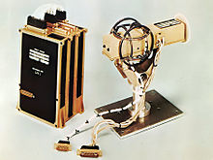
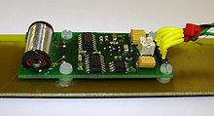
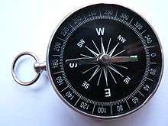
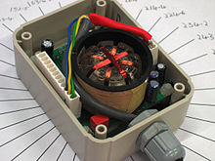
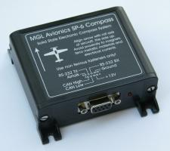
Solid state compasses (Magnetometer)
Recall: most common compasses are simple magnetic based devices.
Invented as early as Chinese Han Dynasty in ~206 BC
https://www.youtube.com/watch?v=20O7cRmNjHE
http://commons.wikimedia.org/w/index.php?title=File%3AFluxgate_Magnetometers.ogv

Slide 3
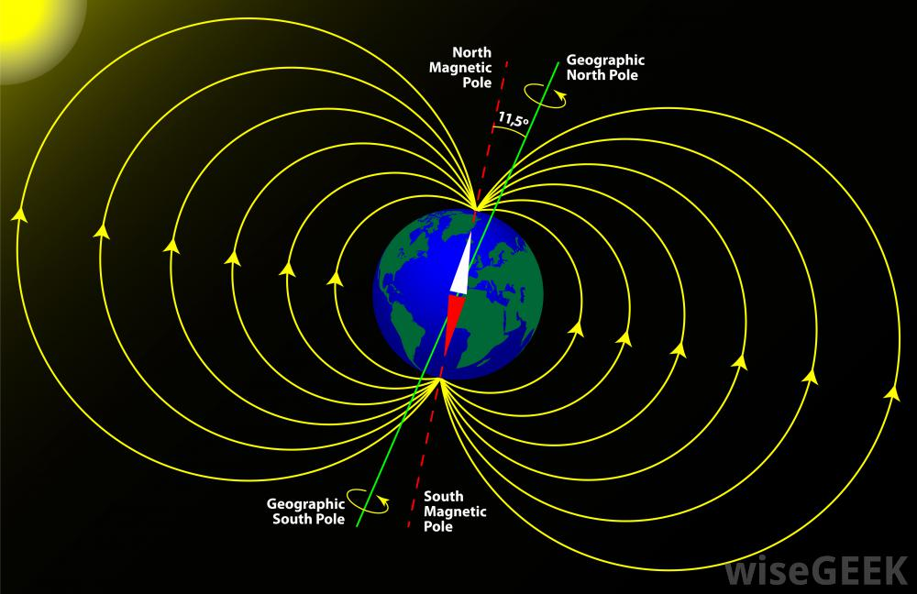

Slide 4
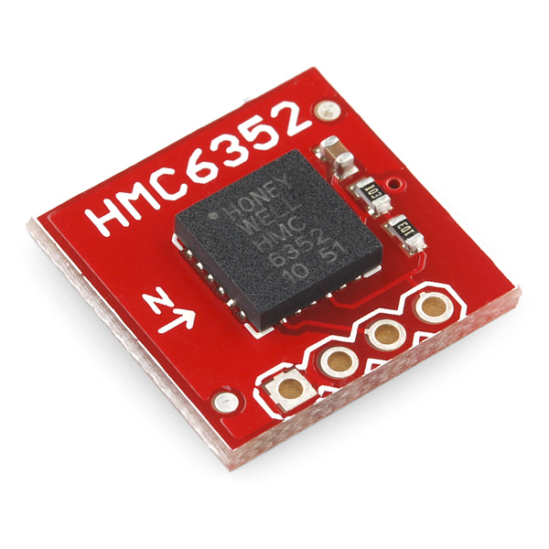
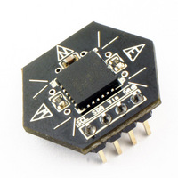
Honeywell HMC6352 2-axis (magneto-resistive sensor)
Features:
Simple I2C interface
2.7 to 5.2V supply range
1 to 20Hz selectable update rate
True drop-in solution
0.5 degree heading resolution
1 degree repeatability
Supply current : 1mA @ 3V
http://www.liquidware.com/shop/show/SEN-CMP/Compass+Module
https://www.youtube.com/watch?v=oxJHsJZWMCU

Slide 5
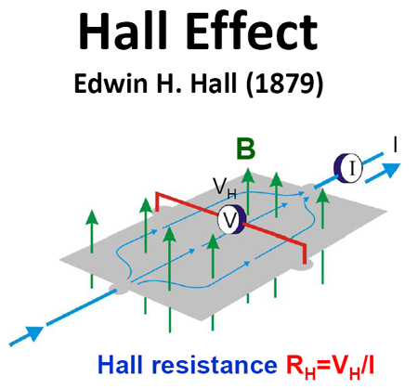
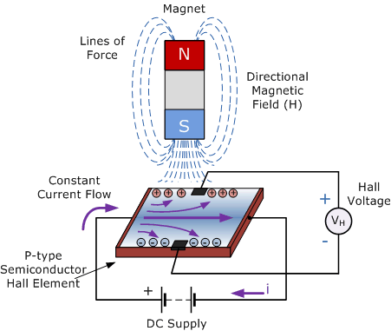
Magnetometer (Hall Effect)
https://www.google.com/search?q=magnetic+vs+geographic+north&biw=1517&bih=725&tbm=isch&tbo=u&source=univ&sa=X&ei=91Z_VLvVBpXhoATry4CQBQ&ved=0CCUQsAQ&dpr=0.9#facrc=_&imgdii=_&imgrc=zx7Zf4OTseclFM%253A%3Bt5-ZZFU2tp3MUM%3Bhttp%253A%252F%252Fimages.wisegeek.com%252Fdrawing-of-earths-magnetic-field.jpg%3Bhttp%253A%252F%252Fwww.wisegeek.com%252Fwhat-is-the-difference-between-the-north-pole-and-magnetic-north-pole.htm%3B1000%3B648

Slide 6
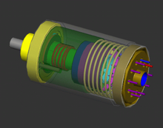
Accelerometer
An accelerometer is a device that measures proper acceleration ("g-force"). Proper acceleration is not the same as coordinate acceleration (rate of change of velocity). For example, an accelerometer at rest on the surface of the Earth will measure an acceleration g= 9.81 m/s² straight upwards. By contrast, accelerometers in free fall orbiting and accelerating due to the gravity of Earth will measure zero.
Conceptually, an accelerometer behaves as a damped mass on a spring. When the accelerometer experiences an acceleration, the mass is displaced to the point that the spring is able to accelerate the mass at the same rate as the casing. The displacement is then measured to give the acceleration.
http://en.wikipedia.org/wiki/Accelerometer

Slide 7
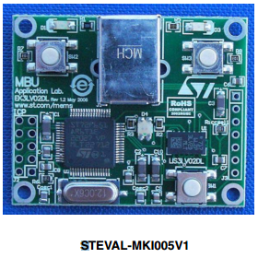
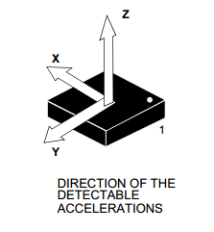
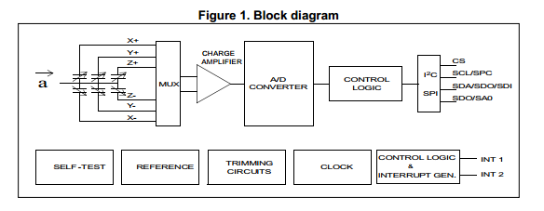
Micro electro-mechanical systems (MEMS)
Simplest MEMS devices possible, consisting of little more than a cantilever beam with a proof mass (also known as seismic mass). Damping results from the residual gas sealed in the device. As long as the Q-factor is not too low, damping does not result in a lower sensitivity.
Under the influence of external accelerations the proof mass deflects from its neutral position. This deflection is measured in an analog or digital manner. Most commonly, the capacitance between a set of fixed beams and a set of beams attached to the proof mass is measured.
Simple, reliable, and inexpensive.
http://www.st.com/web/en/resource/technical/document/data_brief/DM00115750.pdf

Slide 8

Capacitor Based Accelerometers
Capacitors operate both as sensor and actuators
Insensitive to temperature
Relies on variation of capacitance as geometry of capacitor changes
Where A is the area of the electrodes, d the distance between them and the permittivity of the material separating them.
https://drive.google.com/viewerng/viewer?url=http://mafija.fmf.uni-lj.si/seminar/files/2007_2008/MEMS_accelerometers-koncna.pdf

Slide 9
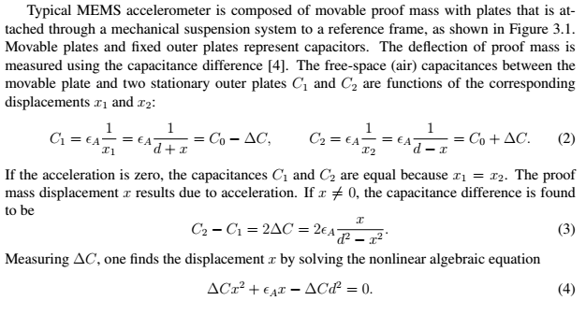
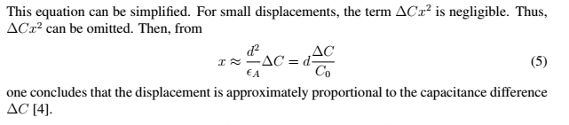
https://drive.google.com/viewerng/viewer?url=http://mafija.fmf.uni-lj.si/seminar/files/2007_2008/MEMS_accelerometers-koncna.pdf

Slide 10
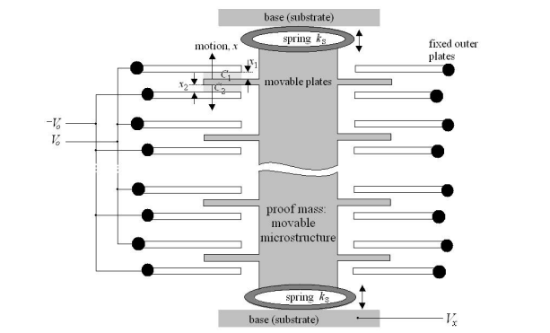
Unlike piezoresitivity, capacitive sensing requires complex readout electronics
Resolve a distance as small as 20 pm, 1/5th of silicon inter-atomic distance
All upper capacitors are wired parallel for an overall capacitance of C_{1.} (same for lower and C₂)
https://drive.google.com/viewerng/viewer?url=http://mafija.fmf.uni-lj.si/seminar/files/2007_2008/MEMS_accelerometers-koncna.pdf

Slide 11
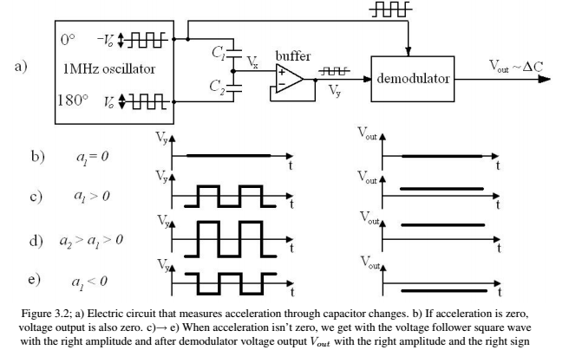
https://drive.google.com/viewerng/viewer?url=http://mafija.fmf.uni-lj.si/seminar/files/2007_2008/MEMS_accelerometers-koncna.pdf

Slide 12
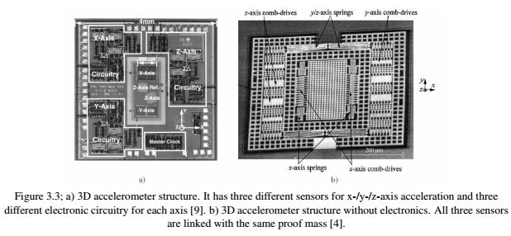
https://drive.google.com/viewerng/viewer?url=http://mafija.fmf.uni-lj.si/seminar/files/2007_2008/MEMS_accelerometers-koncna.pdf

Slide 13
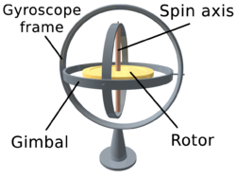
Gyroscope
A device for measuring or maintaining orientation, based on the principles of angular momentum
https://www.youtube.com/watch?v=cquvA_IpEsA

Slide 14
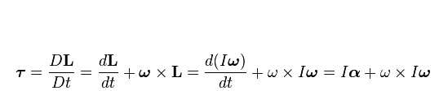
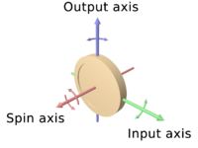

Technical Info
Where the pseudovectors τ and L are, respectively, the torque on the gyroscope and its angular momentum, the scalar I is its moment of inertia, the vector ω is its angular velocity, the vector α is its angular acceleration, D is the differential in an inertial reference frame and d is the differential in a relative reference frame fixed with the gyroscope.
It follows from this that a torque τ applied perpendicular to the axis of rotation, and therefore perpendicular to L, results in a rotation about an axis perpendicular to both τ and L. This motion is called precession. The angular velocity of precession Ω_{P} is given by the cross product:

Slide 15
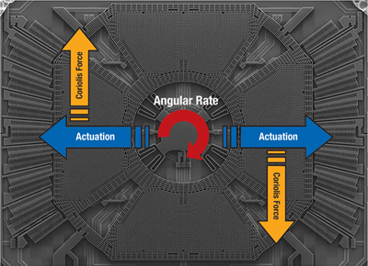
MEMS gyroscope
Inexpensive vibrating structure gyroscopes manufactured with MEMS technology have become widely available. MEMS gyroscopes use the Coriolis Effect to measure the angular rate
Two moving masses are kept in continuous movement in opposite directions, which are indicated by the blue arrows. As soon as an external angular rate is applied, a Coriolis force, which is shown with the orange arrows, will appear in the direction orthogonal to the movement and will cause a displacement of the sensing masses proportional to the magnitude of the rate applied. Since the moving electrodes (rotors) of the sensing portion of the sensor stand beside fixed electrodes (stators), the displacement will induce a change in the electrical capacitance among stators and rotors, thus transforming the angular rate applied at the input of the gyroscope into an electrical parameter detectable by means of a dedicated circuit.
Single-axis yaw gyroscope
http://www.digikey.com/en/articles/techzone/2011/apr/mems-accelerometers-gyroscopes-and-geomagnetic-sensors---propelling-disruptive-consumer-applications

Slide 16
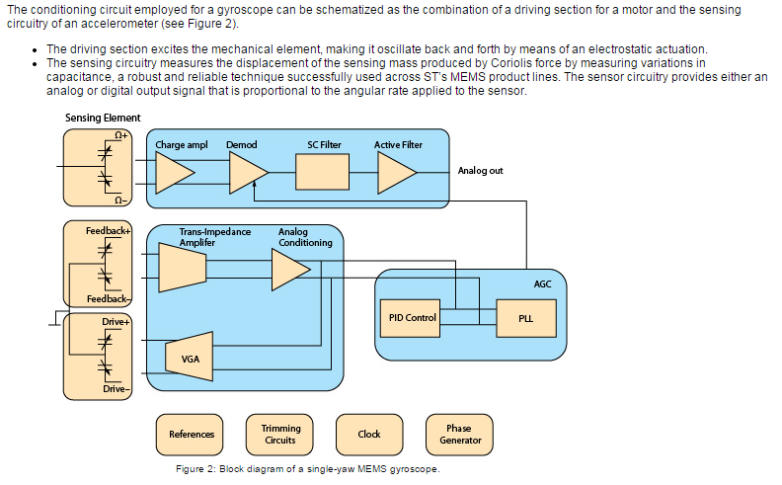
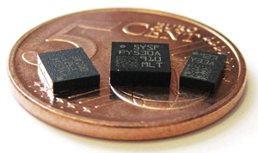
Extra reading: http://electroiq.com/blog/2010/11/introduction-to-mems-gyroscopes/
http://www.digikey.com/en/articles/techzone/2011/apr/mems-accelerometers-gyroscopes-and-geomagnetic-sensors---propelling-disruptive-consumer-applications

